Slide 1
Groofy Code
Competitive Programming Platform

Slide 2
Table of contents
01
02
03
04
Introduction
Features
- Problem Significance
- Project Idea
- Highlight Features
System Analysis
Machine Learning
- Use Cases
- System Structure
- Model Building Journey
05
06
Implementation
Demo
- Technologies

Slide 3
01
Introduction

Slide 4


Introduction & Problem Description
Why don’t I know how to implement it ?
Tasks
Deadlines

Slide 5

Thinking of the solution
What should I do ?
1
Should I solve a lot of problems ?
2
Should I solve hard problems ?
3
What time should I spend in solving ?
4
What about challenging people ?
5
Leetcode ? Codeforces ? ….. etc.

Slide 6
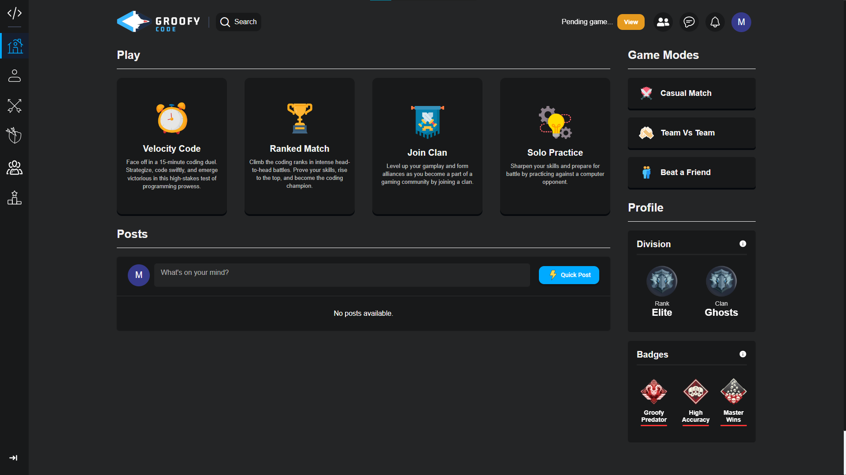
Our Solution: Groofy Code

Slide 7
02
Features

Slide 8
Highlight Features
The key features and functionalities of the project.
1
2
Challenge Mechanism
Comprehensive User System
3
4
Clan Features
Interactive Chat System

Slide 9
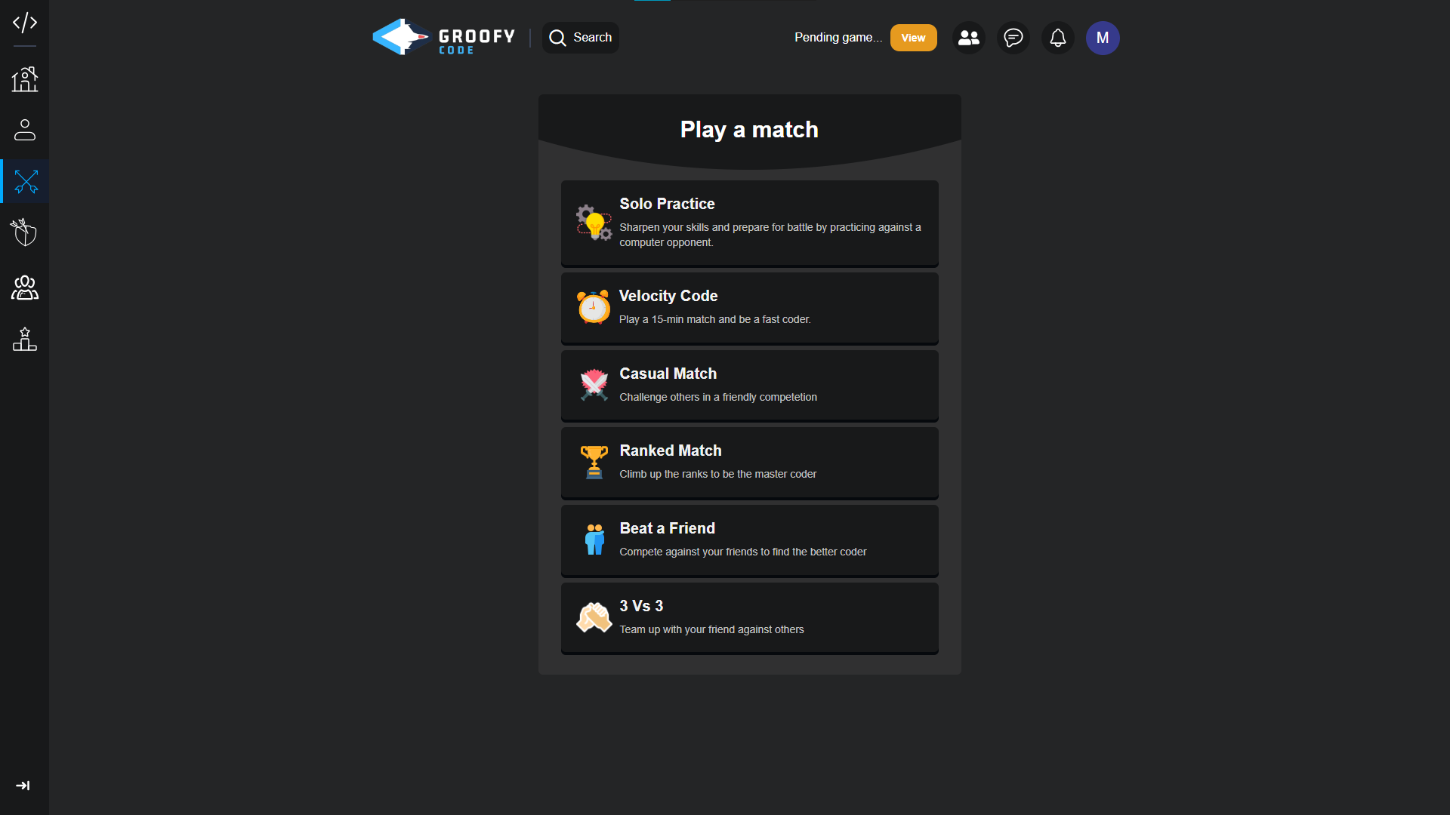
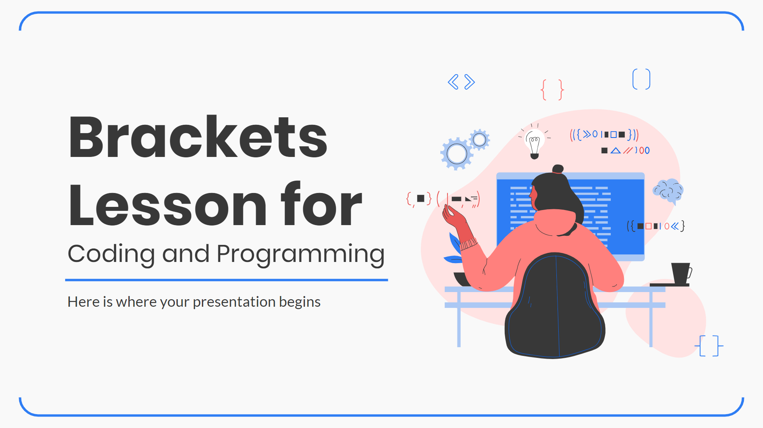
Match Modes
• Various Coding Challenges
• Difficulty Levels

Slide 10
Match Challenge
• Real-time Code Editor
• Submission and Evaluation

Slide 11
User Profile
• User Registration / Login
• Profile Creation
• Personalized Dashboard
• Insightful User Statistics

Slide 12
User Interactions
• View users’ profile
• Friend Requests
• Notification system
• Invite a Friend to Match/Clan
• Posts

Slide 13
Clan Feature
• Viewing Clan members
• Collaborate with people
• Messaging members
• Play with them

Slide 14
Chat System
• Viewing Friends
• Message a user
• Search for a friend

Slide 15
03
System Analysis

Slide 16
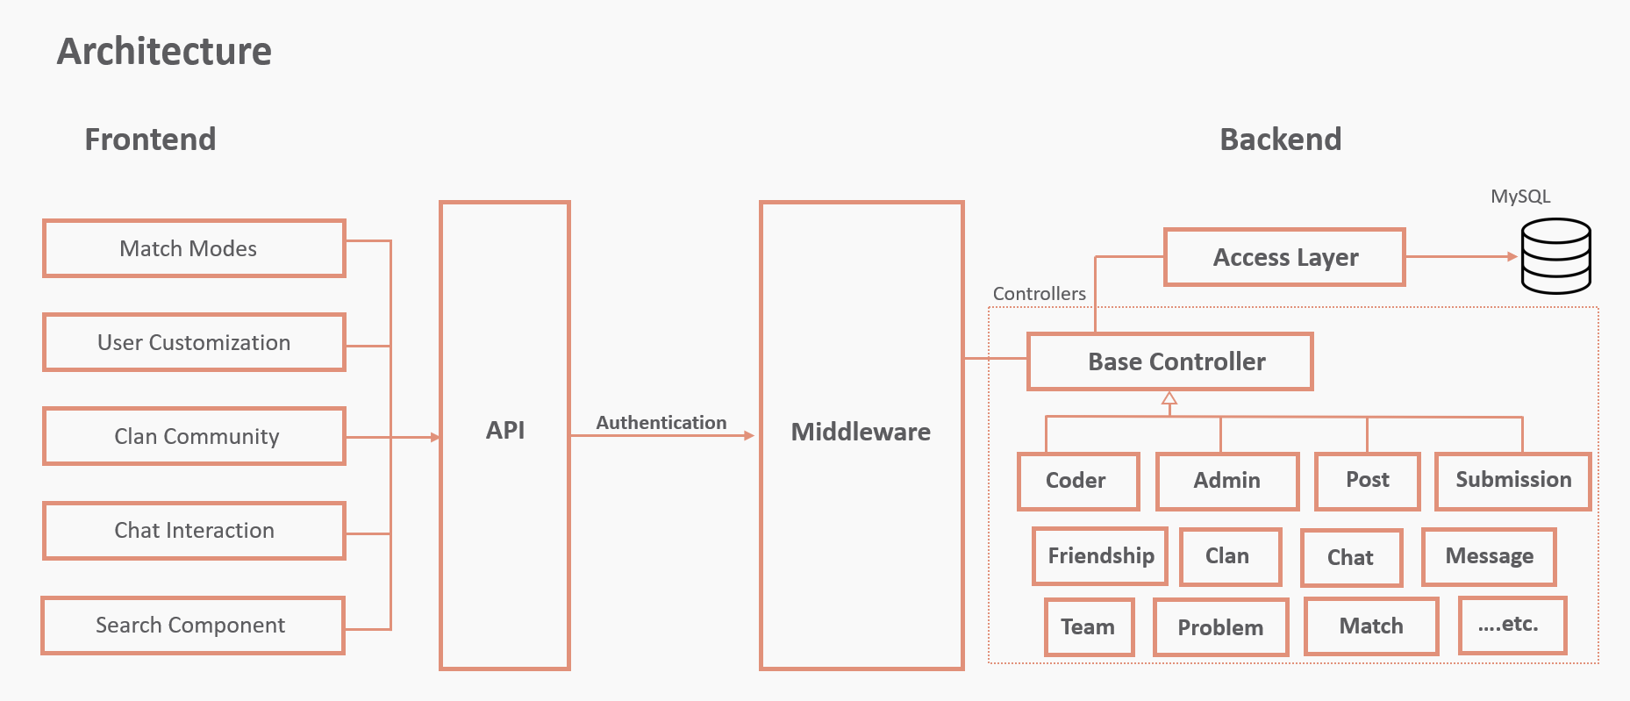
What coding languages use brackets?

Slide 17
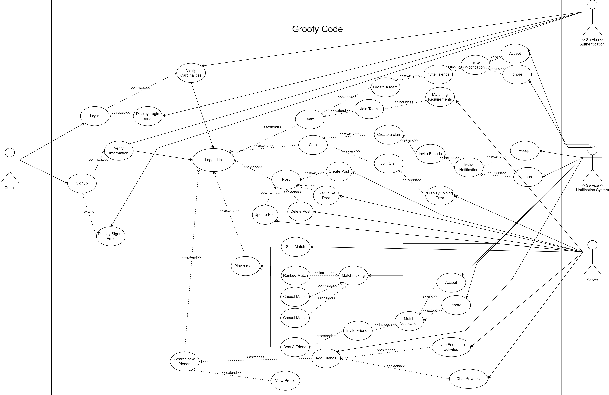
Use Case Diagram

Slide 18
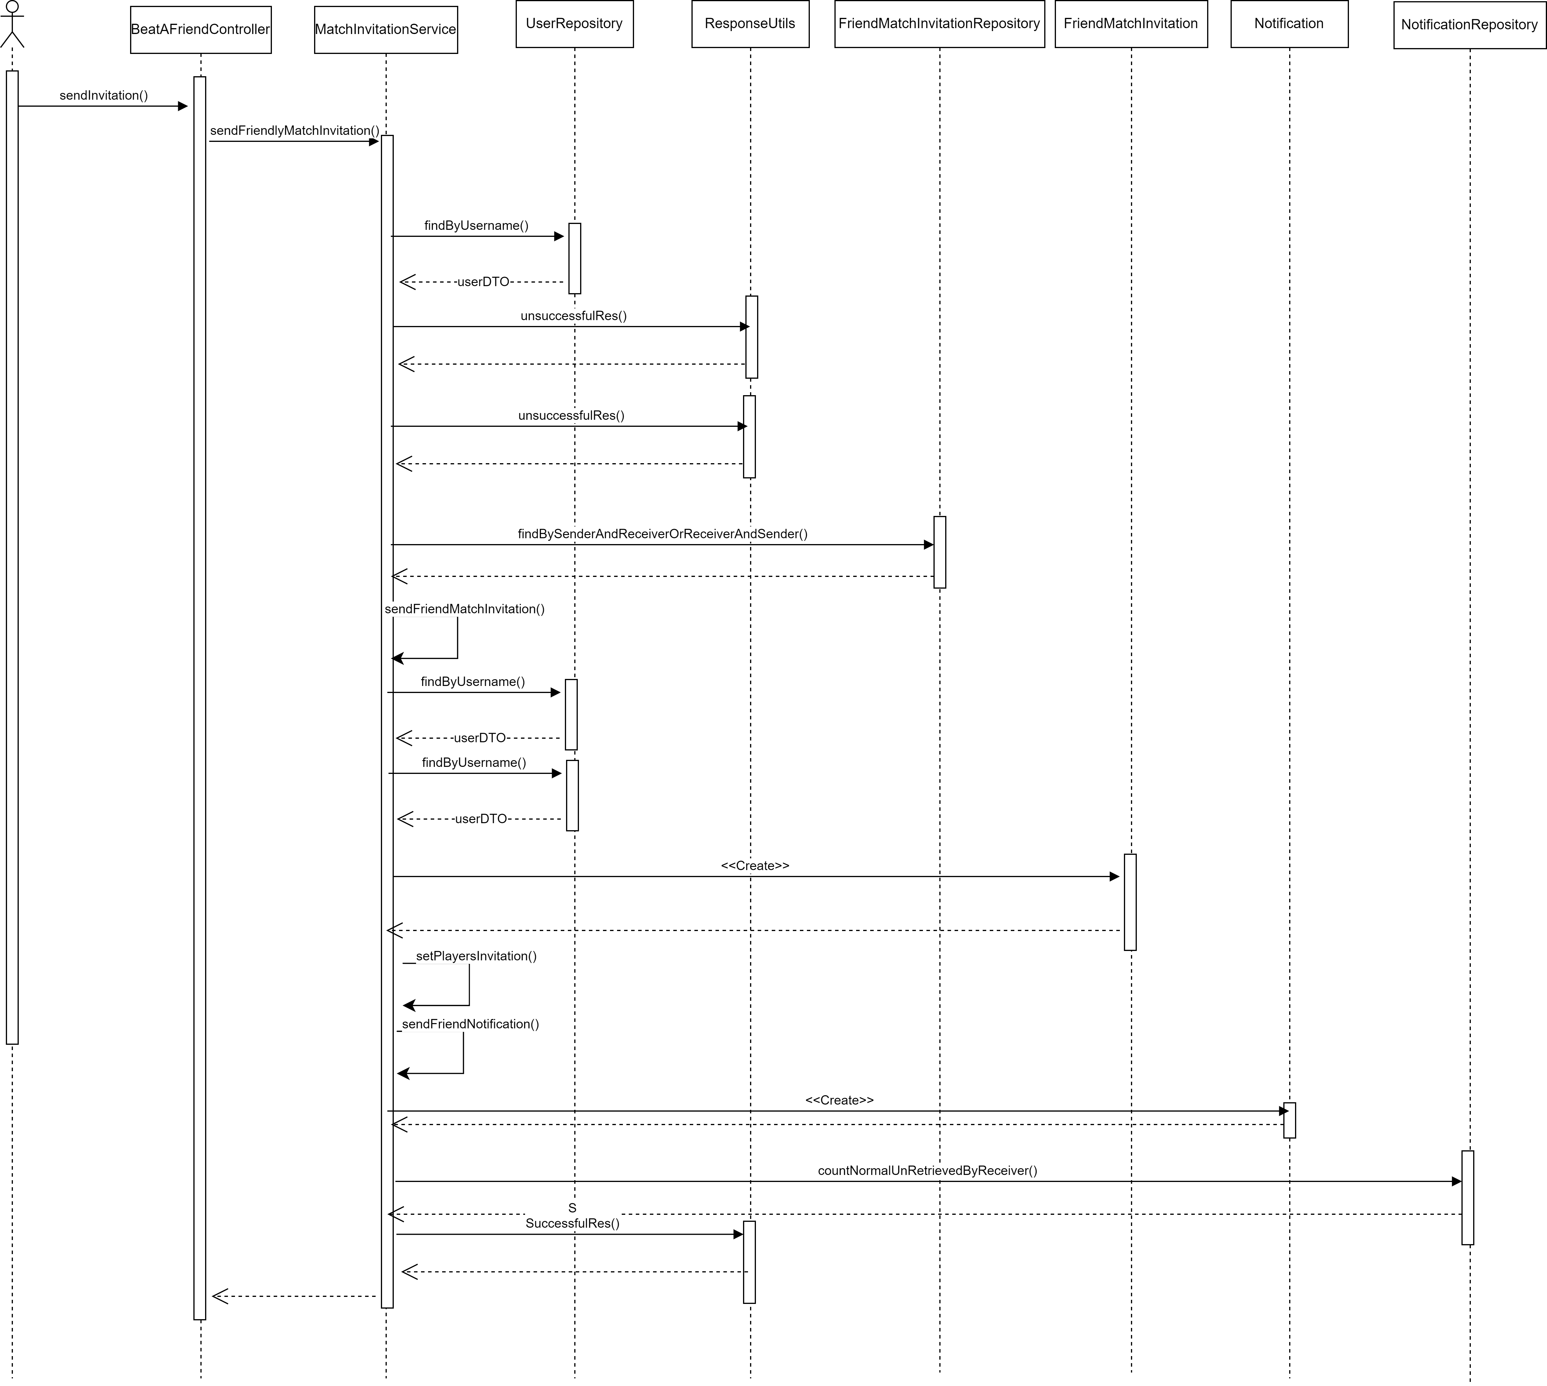
Send Invitation Friendly Match Sequence Diagram

Slide 19
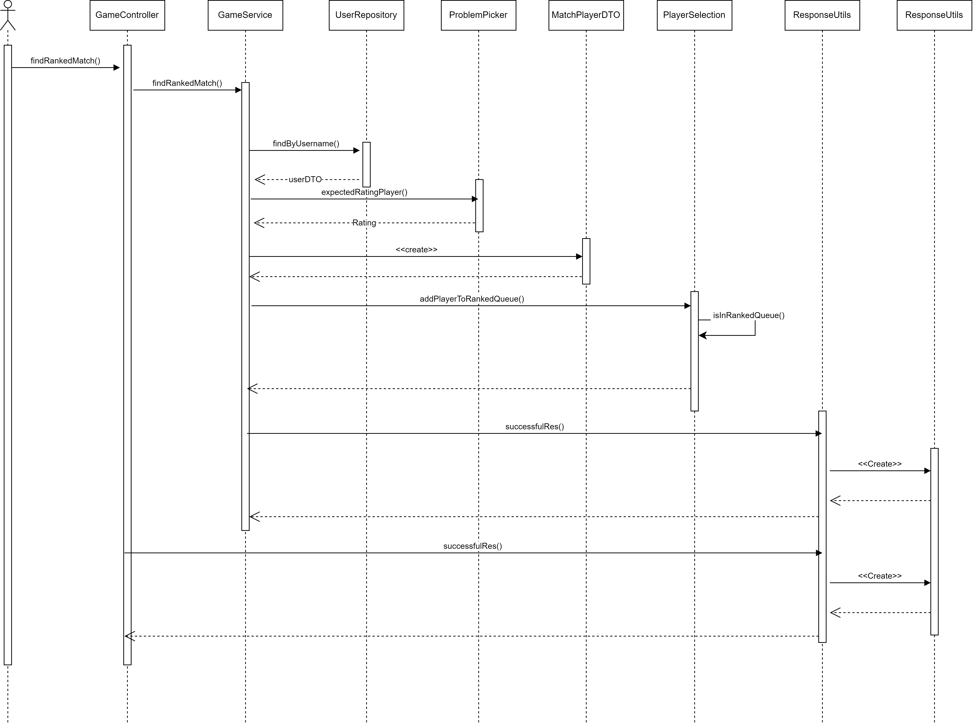
Ranked Match Sequence Diagram

Slide 20
Ranked Match Sequence Diagram

Slide 21
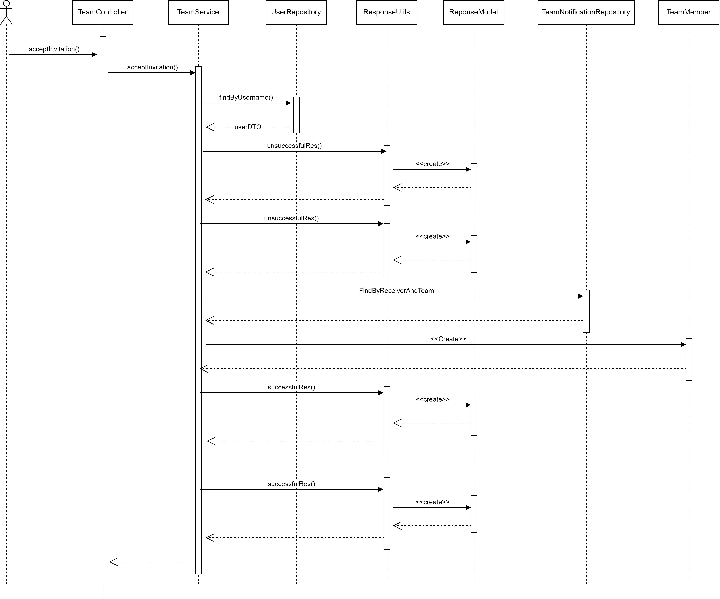
Accept Team Invitation Sequence Diagram

Slide 22
Non-Functional Requirements
Scalability
Useability
Portability
Scaled Horizontally
At most 5 clicks
Media Query
Performance
Security
Reliability
Response Time 2s
Passwords Encryption
Multi-layer Filters
Real-Time tracks and
updates

Slide 23
04
Machine Learning

Slide 24
Machine Learning
Data Collection
Challenges
Preprocessing the data
Deal with Codeforces API
[ ]
Solution
Model
Coming up with Algorithm for Data results
Using Random Forest

Slide 25
05
Technologies

Slide 26










Technologies & Libraries Used
Backend
Frontend

Slide 27
Gantt Chart

Slide 28
06
Demo

Slide 29
Thanks!
Thank you for your time and attention.

